Slide 1
236781
Lecture 7
Deep Learning
Attention and Transformers
Dr. Chaim Baskin

Slide 2
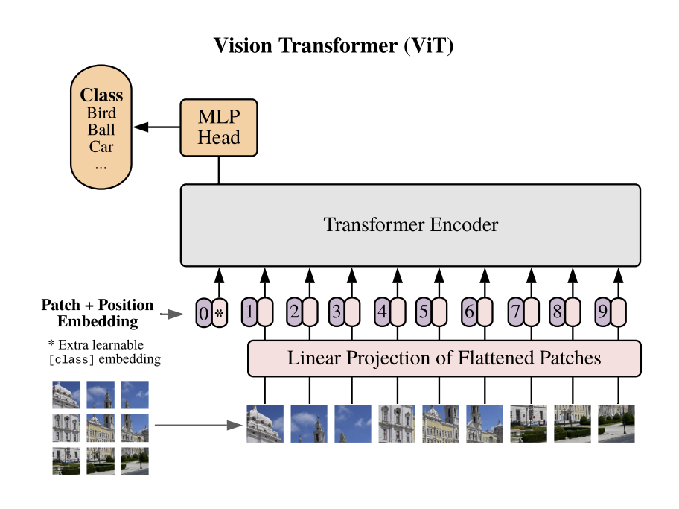
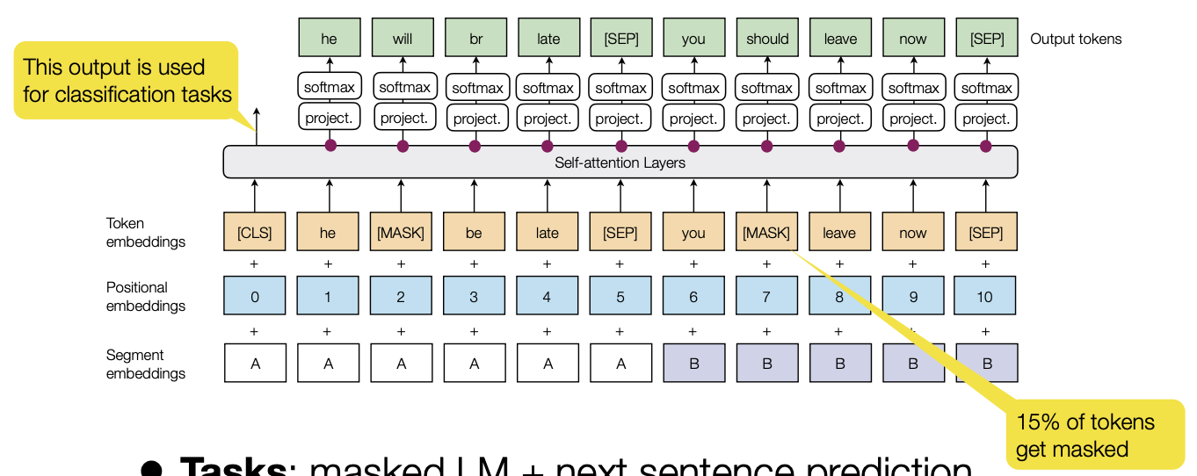
Transformers for large-scale language and image modeling

Slide 3
Outline
Basic transformer model (review and details)
Transformer-based language models
BERT
GPT
Other models
Concerns
Models for vision and language
Image transformers
Image-text transformers: CLIP, DALL-E

Slide 4
Basic transformer model (review)
Sequence-to-sequence architecture using only point-wise processing and attention (no recurrent units or convolutions)
Encoder: receives entire input sequence and outputs encoded sequence of the same length
Decoder: predicts next token conditioned on encoder output and previously predicted tokens
A. Vaswani, N. Shazeer, N. Parmar, J. Uszkoreit, L. Jones, A. Gomez, L. Kaiser, I. Polosukhin, Attention is all you need, NeurIPS 2017
Image source

Slide 5
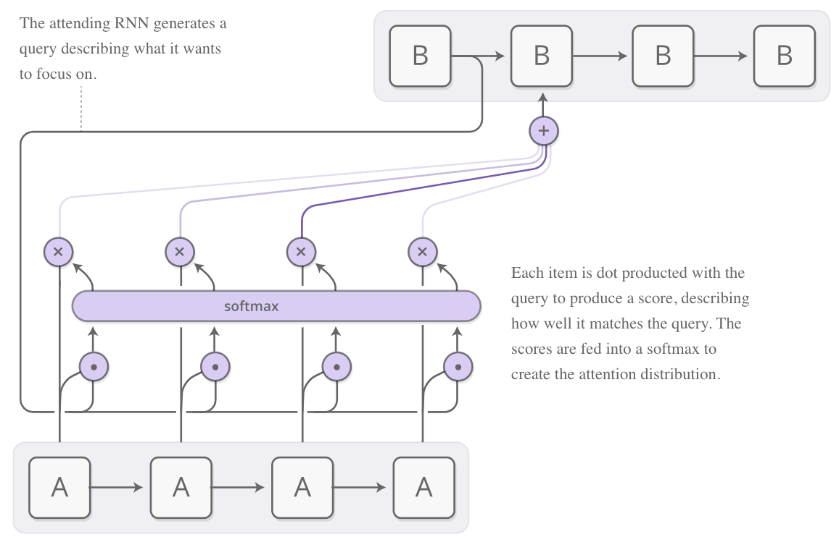
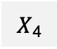
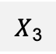
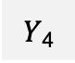
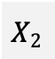
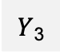
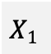
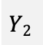
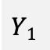
Key-Value-Query attention model
Decoder
The decoder generates a query describing what it wants to focus on
$$Y1$$
$$Y2$$
$Y$₃
$Y$₄
Sum the values generated by encoder weighted by the attention weights
Feed the scores into a softmax to create the attention weights
Compute dot products between the query and the keys generated by encoder, giving alignment scores between source tokens and the query
$$X1$$
$$X2$$
$X$₃
$X$₄
Encoder
Image source

Slide 6
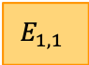
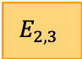
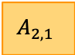
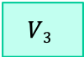
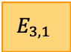
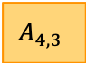
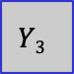
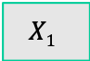
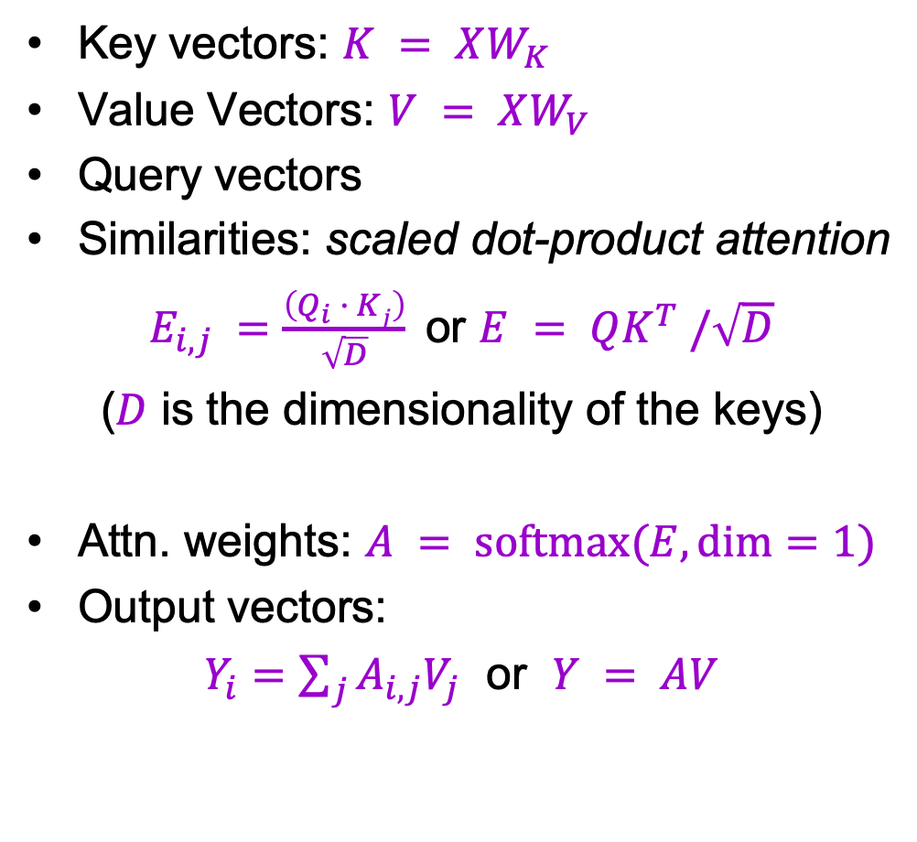
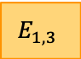
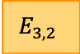

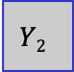
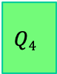
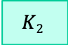
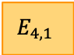
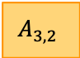
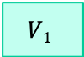
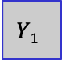
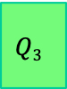
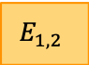

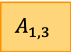

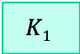
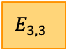
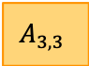

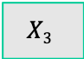
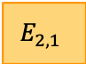
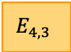
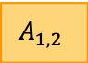

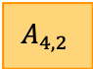
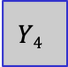
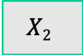
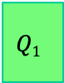
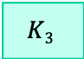
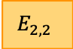

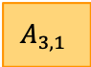
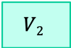
Key-Value-Query attention model
$$Y1$$
$$Y2$$
$$Y3$$
$$Y4$$
Key vectors: $K = XW_{K}$
Value Vectors: $V = XW_{V}$
Query vectors
Similarities: scaled dot-product attention
$E_{i,j} =\frac{\left(Q_{i} · Kj\right)}{\sqrt{D}}$ or $E = QK^{T} /\sqrt{D}$
($D$ is the dimensionality of the keys)
Attn. weights: $A = softmax(E, dim=1)$
Output vectors:
$Y_{i}=\sum_{j}{A_{i,j}V_{j}}$ or $Y = AV$
Product( ), Sum( )
$$V1$$
$$A_{1,1}$$
$$A_{2,1}$$
$$A_{3,1}$$
$$A_{4,1}$$
$$V2$$
$$A_{1,2}$$
$$A_{2,2}$$
$$A_{3,2}$$
$$A_{4,2}$$
$$V3$$
$$A_{1,3}$$
$$A_{2,3}$$
$$A_{3,3}$$
$$A_{4,3}$$
Softmax( )
$$X1$$
$$K1$$
$$E_{1,1}$$
$$E_{2,1}$$
$$E_{3,1}$$
$$E_{4,1}$$
$$X2$$
$$K2$$
$$E_{1,2}$$
$$E_{2,2}$$
$$E_{3,2}$$
$$E_{4,2}$$
$$X3$$
$$K3$$
$$E_{1,3}$$
$$E_{2,3}$$
$$E_{3,3}$$
$$E_{4,3}$$
$$Q1$$
$$Q2$$
$$Q3$$
$$Q4$$
Adapted from J. Johnson

Slide 7
Key-Value-Query attention model
$$Y1$$
$$Y2$$
$$Y3$$
$$Y4$$
How does permuting the order of the queries change the output?
How does changing the order of the keys/values change the output?
Product( ), Sum( )
$$V1$$
$$A_{1,1}$$
$$A_{2,1}$$
$$A_{3,1}$$
$$A_{4,1}$$
$$V2$$
$$A_{1,2}$$
$$A_{2,2}$$
$$A_{3,2}$$
$$A_{4,2}$$
$$V3$$
$$A_{1,3}$$
$$A_{2,3}$$
$$A_{3,3}$$
$$A_{4,3}$$
Softmax( )
$$X1$$
$$K1$$
$$E_{1,1}$$
$$E_{2,1}$$
$$E_{3,1}$$
$$E_{4,1}$$
$$X2$$
$$K2$$
$$E_{1,2}$$
$$E_{2,2}$$
$$E_{3,2}$$
$$E_{4,2}$$
$$X3$$
$$K3$$
$$E_{1,3}$$
$$E_{2,3}$$
$$E_{3,3}$$
$$E_{4,3}$$
$$Q1$$
$$Q2$$
$$Q3$$
$$Q4$$
Adapted from J. Johnson

Slide 8
Attention mechanisms
Encoder self-attention: queries, keys, and values come from previous layer of encoder
Decoder self-attention: values corresponding to future decoder outputs are masked out
Encoder-decoder attention: queries come from previous decoder layer, keys and values come from output of encoder

Slide 9
Self-attention
Used to capture context within the sequence
As we are encoding “it”, we should focus on “the animal”
As we are encoding “it”, we should focus on “the street”
Image source

Slide 10
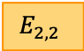
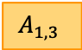
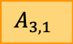































Self-attention layer
$$Y1$$
$$Y2$$
$$Y3$$
Query vectors: $Q= XW_{Q}$
Key vectors: $K = XW_{K}$
Value vectors: $V = XW_{V}$
Similarities: scaled dot-product attention
$E_{i,j} =\frac{\left(Q_{i}· Kj\right)}{\sqrt{D}}$ or $E = QK^{T} /\sqrt{D}$
($D$ is the dimensionality of the keys)
Attn. weights: $A = softmax(E, dim=1)$
Output vectors:
$Y_{i}=\sum_{j}{A_{i,j}V_{j}}$ or $Y = AV$
Product(→), Sum(↑)
$$V3$$
$$A_{1,3}$$
$$A_{2,3}$$
$$A_{3,3}$$
$$V2$$
$$A_{1,2}$$
$$A_{2,2}$$
$$A_{3,2}$$
$$V1$$
$$A_{1,1}$$
$$A_{2,1}$$
$$A_{3,1}$$
Softmax(↑)
$$K3$$
$$E_{1,3}$$
$$E_{2,3}$$
$$E_{3,3}$$
$$K2$$
$$E_{1,2}$$
$$E_{2,2}$$
$$E_{3,2}$$
$$K1$$
$$E_{1,1}$$
$$E_{2,1}$$
$$E_{3,1}$$
$$Q1$$
$$Q2$$
$$Q3$$
$$X1$$
$$X2$$
$$X3$$
Adapted from J. Johnson
One query per input vector

Slide 11





























Masked self-attention layer
This
is
….
$$Y1$$
$$Y2$$
$$Y3$$
The decoder should not “look ahead” in the output sequence
Product(→), Sum(↑)
$$V3$$
$$A_{1,3}$$
$$A_{2,3}$$
$$A_{3,3}$$
$$V2$$
$$A_{1,2}$$
$$A_{2,2}$$
$$A_{3,2}$$
$$V1$$
$$A_{1,1}$$
$$A_{2,1}$$
$$A_{3,1}$$
Softmax(↑)
$$K3$$
$$E_{1,3}$$
$$E_{2,3}$$
$$E_{3,3}$$
$$K2$$
$$E_{1,2}$$
$$E_{2,2}$$
$$E_{3,2}$$
$$K1$$
$$E_{1,1}$$
$$E_{2,1}$$
$$E_{3,1}$$
$$Q1$$
$$Q2$$
$$Q3$$
$$X1$$
$$X2$$
$$X3$$
<START>
This
is
Adapted from J. Johnson

Slide 12
Masked self-attention layer
$$Y1$$
$$Y2$$
$$Y3$$
The decoder should not “look ahead” in the output sequence
Product(→), Sum(↑)
$$V3$$
$$A_{1,3}$$
$$A_{2,3}$$
$$A_{3,3}$$
$$V2$$
$$A_{1,2}$$
$$A_{2,2}$$
$$A_{3,2}$$
$$V1$$
$$A_{1,1}$$
$$A_{2,1}$$
$$A_{3,1}$$
Softmax(↑)
$$K3$$
$$E_{1,3}$$
$$E_{2,3}$$
$$E_{3,3}$$
$$K2$$
$$E_{1,2}$$
$$E_{2,2}$$
$$E_{3,2}$$
$$K1$$
$$E_{1,1}$$
$$E_{2,1}$$
$$E_{3,1}$$
$$Q1$$
$$Q2$$
$$Q3$$
$$X1$$
$$X2$$
$$X3$$
Adapted from J. Johnson

Slide 13






Masked self-attention layer
$$Y1$$
$$Y2$$
$$Y3$$
The decoder should not “look ahead” in the output sequence
Product(→), Sum(↑)
$$V3$$
$$0$$
$$0$$
$$A_{3,3}$$
$$V2$$
$$0$$
$$A_{2,2}$$
$$A_{3,2}$$
$$V1$$
$$A_{1,1}$$
$$A_{2,1}$$
$$A_{3,1}$$
Softmax(↑)
$$K3$$
$$−∞$$
$$−∞$$
$$E_{3,3}$$
$$K2$$
$$−∞$$
$$E_{2,2}$$
$$E_{3,2}$$
$$K1$$
$$E_{1,1}$$
$$E_{2,1}$$
$$E_{3,1}$$
$$Q1$$
$$Q2$$
$$Q3$$
$$X1$$
$$X2$$
$$X3$$
Adapted from J. Johnson

Slide 14
Attention mechanisms: Summary
N transformer blocks
N transformer blocks
Encoder self-attention: queries, keys, and values come from previous layer of encoder
Decoder self-attention: values corresponding to future decoder outputs are masked out
Encoder-decoder attention: queries come from previous decoder layer, keys and values come from output of encoder

Slide 15

Attention mechanisms: Illustration
https://ai.googleblog.com/2017/08/transformer-novel-neural-network.html

Slide 16

Transformer architecture: Details
Decoder
Encoder
A. Vaswani et al., Attention is all you need, NeurIPS 2017

Slide 17


Multi-head attention
Run $h$ attention models in parallel on top of different linearly projected versions of $Q, K, V$; concatenate and linearly project the results
Intuition: enables model to attend to different kinds of information at different positions (see visualization tool)
Notes:
“Multi-head attention allows the model to jointly attend to information from different representation subspaces at different positions. With a single attention head, averaging inhibits this.”

Slide 18

Transformer blocks
A Transformer is a sequence of transformer blocks
Vaswani et al.: N=12 blocks, embedding dimension = 512, 6 attention heads
Add & Norm: residual connection followed by layer normalization
Feedforward: two linear layers with ReLUs in between, applied independently to each vector
Attention is the only interaction between inputs!

Slide 19
Transformer block
Layer Normalization:
Given h₁, …, h_{N} (Shape: D)
scale: 𝛾 (Shape: D)
shift: 𝛽 (Shape: D)
𝜇_{i} = (∑_{j} h_{i,j})/D (scalar)
𝜎_{i} = (∑_{j} (h_{i,j} - 𝜇_{i})²/D)^{1/2} (scalar)
z_{i} = (h_{i} - 𝜇_{i}) / 𝜎_{i}
y_{i} = 𝛾 * z_{i} + 𝛽
Ba et al, 2016
Residual connection
MLP independently on each vector
Residual connection
All vectors interact with each other

Slide 20
Positional encoding
To give transformer information about ordering of tokens, add function of position (based on sines and cosines) to every input
position
Embedding dimension
Image source

Slide 21
Transformer architecture: Zooming back out
Decoder
Encoder
A. Vaswani et al., Attention is all you need, NeurIPS 2017

Slide 22
Results
https://ai.googleblog.com/2017/08/transformer-novel-neural-network.html

Slide 23

Different ways of processing sequences

Slide 24
Different ways of processing sequences
RNN
1D convolutional network
Transformer
h₁
h₂
h₃
h₄
h₁
h₂
h₃
h₄
x₁
x₂
x₃
x₄
x₁
x₂
x₃
x₄
Works on ordered sequences
Pros: Good for long sequences: After one RNN layer, h_{T} ”sees” the whole sequence
Con: Not parallelizable: need to compute hidden states sequentially
Con: Hidden states have limited expressive capacity
Works on multidimensional grids
Pro: Each output can be computed in parallel (at training time)
Con: Bad at long sequences: Need to stack many conv layers for outputs to “see” the whole sequence
Works on sets of vectors
Pro: Good at long sequences: after one self-attention layer, each output “sees” all inputs!
Pro: Each output can be computed in parallel (at training time)
Con: Memory-intensive

Slide 25
Outline
Basic transformer model
Transformer-based language models
BERT
GPT
Other models
Concerns

Slide 26

Self-supervised language modeling with transformers
Download A LOT of text from the internet
Train a giant transformer using a suitable pretext task
Fine-tune the transformer on desired NLP task
Image source

Slide 27

Self-supervised language modeling with transformers
Download A LOT of text from the internet
Train a giant transformer using a suitable pretext task
Fine-tune the transformer on desired NLP task
Bidirectional Encoder Representations from Transformers (BERT)
J. Devlin, M.-W. Chang, K. Lee, K. Toutanova, BERT: Pre-training of Deep Bidirectional Transformers for Language Understanding, EMNLP 2018

Slide 28
BERT: Pretext tasks
Masked language model (MLM)
Randomly mask 15% of tokens in input sentences, goal is to reconstruct them using bidirectional context
Image source

Slide 29
BERT: Pretext tasks
Next sentence prediction (NSP)
Useful for Question Answering and Natural Language Inference tasks
In the training data, 50% of the time B is the actual sentence that follows A (labeled as IsNext), and 50% of the time it is a random sentence (labeled as NotNext).
Predict likelihood that sentence B belongs after sentence A
Image source

Slide 30
BERT: More detailed view
WordPiece (from GNMT)
Trained on Wikipedia (2.5B words) + BookCorpus (800M words)
Image source

Slide 31

BERT: Evaluation
General Language Understanding Evaluation (GLUE) benchmark (gluebenchmark.com)

Slide 32


BERT: Downstream tasks
Textual entailment
Source: J. Hockenmaier
Entailment, textual equivalence and similarity

Slide 33

BERT: Downstream tasks
Sentiment classification, linguistic acceptability
Image source

Slide 34


BERT: Downstream tasks
Find span in paragraph that contains the answer
Source: SQuAD v1.1 paper

Slide 35

BERT: Downstream tasks
Image source
Named entity recognition

Slide 36

Other language models
Image source

Slide 37

Other language models
Image source

Slide 38
Scaling up transformers
Source: J. Johnson
Model | Layers | Hidden dim. | Heads | Params | Data | Training
Transformer-Base | 12 | 512 | 8 | 65M |  | 8x P100 (12 hours)
Transformer-Large | 12 | 1024 | 16 | 213M |  | 8x P100 (3.5 days)
Vaswani et al., Attention is all you need, NeurIPS 2017

Slide 39
Scaling up transformers
Source: J. Johnson
Model | Layers | Hidden dim. | Heads | Params | Data | Training
Transformer-Base | 12 | 512 | 8 | 65M |  | 8x P100 (12 hours)
Transformer-Large | 12 | 1024 | 16 | 213M |  | 8x P100 (3.5 days)
BERT-Base | 12 | 768 | 12 | 110M | 13 GB | 4x TPU (4 days)
BERT-Large | 24 | 1024 | 16 | 340M | 13 GB | 16x TPU (4 days)
Devlin et al., BERT: Pre-training of Deep Bidirectional Transformers for Language Understanding, EMNLP 2018

Slide 40
Scaling up transformers
Source: J. Johnson
Model | Layers | Hidden dim. | Heads | Params | Data | Training
Transformer-Base | 12 | 512 | 8 | 65M |  | 8x P100 (12 hours)
Transformer-Large | 12 | 1024 | 16 | 213M |  | 8x P100 (3.5 days)
BERT-Base | 12 | 768 | 12 | 110M | 13 GB | 4x TPU (4 days)
BERT-Large | 24 | 1024 | 16 | 340M | 13 GB | 16x TPU (4 days)
XLNet-Large | 24 | 1024 | 16 | ~340M | 126 GB | 512x TPU-v3 (2.5 days)
RoBERTa | 24 | 1024 | 16 | 355M | 160 GB | 1024x V100 GPU (1 day)
Yang et al., XLNet: Generalized Autoregressive Pretraining for Language Understanding, 2019
Liu et al., RoBERTa: A Robustly Optimized BERT Pretraining Approach, 2019

Slide 41
Scaling up transformers
Source: J. Johnson
Model | Layers | Hidden dim. | Heads | Params | Data | Training
Transformer-Base | 12 | 512 | 8 | 65M |  | 8x P100 (12 hours)
Transformer-Large | 12 | 1024 | 16 | 213M |  | 8x P100 (3.5 days)
BERT-Base | 12 | 768 | 12 | 110M | 13 GB | 4x TPU (4 days)
BERT-Large | 24 | 1024 | 16 | 340M | 13 GB | 16x TPU (4 days)
XLNet-Large | 24 | 1024 | 16 | ~340M | 126 GB | 512x TPU-v3 (2.5 days)
RoBERTa | 24 | 1024 | 16 | 355M | 160 GB | 1024x V100 GPU (1 day)
GPT-2 | 48 | 1600 | ? | 1.5B | 40 GB
Radford et al., Language models are unsupervised multitask learners, 2019

Slide 42
Scaling up transformers
Source: J. Johnson
Model | Layers | Hidden dim. | Heads | Params | Data | Training
Transformer-Base | 12 | 512 | 8 | 65M |  | 8x P100 (12 hours)
Transformer-Large | 12 | 1024 | 16 | 213M |  | 8x P100 (3.5 days)
BERT-Base | 12 | 768 | 12 | 110M | 13 GB | 4x TPU (4 days)
BERT-Large | 24 | 1024 | 16 | 340M | 13 GB | 16x TPU (4 days)
XLNet-Large | 24 | 1024 | 16 | ~340M | 126 GB | 512x TPU-v3 (2.5 days)
RoBERTa | 24 | 1024 | 16 | 355M | 160 GB | 1024x V100 GPU (1 day)
GPT-2 | 48 | 1600 | ? | 1.5B | 40 GB
Megatron-LM | 72 | 3072 | 32 | 8.3B | 174 GB | 512x V100 GPU (9 days)
~$430,000 on Amazon AWS!
Shoeybi et al., Megatron-LM: Training Multi-Billion Parameter Languge Models using Model Parallelism, 2019

Slide 43
Scaling up transformers
Source: J. Johnson
Model | Layers | Hidden dim. | Heads | Params | Data | Training
Transformer-Base | 12 | 512 | 8 | 65M |  | 8x P100 (12 hours)
Transformer-Large | 12 | 1024 | 16 | 213M |  | 8x P100 (3.5 days)
BERT-Base | 12 | 768 | 12 | 110M | 13 GB | 4x TPU (4 days)
BERT-Large | 24 | 1024 | 16 | 340M | 13 GB | 16x TPU (4 days)
XLNet-Large | 24 | 1024 | 16 | ~340M | 126 GB | 512x TPU-v3 (2.5 days)
RoBERTa | 24 | 1024 | 16 | 355M | 160 GB | 1024x V100 GPU (1 day)
GPT-2 | 48 | 1600 | ? | 1.5B | 40 GB
Megatron-LM | 72 | 3072 | 32 | 8.3B | 174 GB | 512x V100 GPU (9 days)
Turing-NLG | 78 | 4256 | 28 | 17B | ? | 256x V100 GPU
Microsoft, Turing-NLG: A 17-billion parameter language model by Microsoft, 2020

Slide 44
Scaling up transformers
Source: J. Johnson
Model | Layers | Hidden dim. | Heads | Params | Data | Training
Transformer-Base | 12 | 512 | 8 | 65M |  | 8x P100 (12 hours)
Transformer-Large | 12 | 1024 | 16 | 213M |  | 8x P100 (3.5 days)
BERT-Base | 12 | 768 | 12 | 110M | 13 GB | 4x TPU (4 days)
BERT-Large | 24 | 1024 | 16 | 340M | 13 GB | 16x TPU (4 days)
XLNet-Large | 24 | 1024 | 16 | ~340M | 126 GB | 512x TPU-v3 (2.5 days)
RoBERTa | 24 | 1024 | 16 | 355M | 160 GB | 1024x V100 GPU (1 day)
GPT-2 | 48 | 1600 | ? | 1.5B | 40 GB
Megatron-LM | 72 | 3072 | 32 | 8.3B | 174 GB | 512x V100 GPU (9 days)
Turing-NLG | 78 | 4256 | 28 | 17B | ? | 256x V100 GPU
GPT-3 | 96 | 12288 | 96 | 175B | 694GB | ?
~$4.6M, 355 GPU-years
(source)
Brown et al., Language Models are Few-Shot Learners, NeurIPS 2020 (Best Paper Award)

Slide 45

OpenAI GPT (Generative Pre-Training)
Pre-training task: next token prediction (causal language modeling)
A. Radford et al., Improving language understanding with unsupervised learning, 2018
Image source

Slide 46

GPT-2 and GPT-3
Key idea: if the model and training datasets are big enough, model can adapt to new tasks without fine-tuning
Model | Layers | Hidden dim. | Heads | Params | Dataset
GPT-2 | 48 | 1600 | ? | 1.5B | WebText: 40GB
GPT-3 | 96 | 12288 | 96 | 175B | CommonCrawl (cleaned up): 694GB
GPT-2: A. Radford et al., Language models are unsupervised multitask learners, 2019
GPT-3: T. Brown et al., Language models are few-shot learners, NeurIPS 2020 (Best Paper Award)
Notes:
From the GPT-2 abstract: Natural language processing tasks, such as question answering, machine translation, reading comprehension, and summarization, are typically approached with supervised learning on task-specific datasets. We demonstrate that language models begin to learn these tasks without any explicit supervision when trained on a new dataset of millions of webpages called WebText. When conditioned on a document plus questions, the answers generated by the language model reach 55 F1 on the CoQA dataset - matching or exceeding the performance of 3 out of 4 baseline systems without using the 127,000+ training examples. The capacity of the language model is essential to the success of zero-shot task transfer and increasing it improves performance in a log-linear fashion across tasks. Our largest model, GPT-2, is a 1.5B parameter Transformer that achieves state of the art results on 7 out of 8 tested language modeling datasets in a zero-shot setting but still underfits WebText.
From the GPT-3 abstract: we show that scaling up language models greatly improves task-agnostic, few-shot performance, sometimes even reaching competitiveness with prior state-of-the-art finetuning approaches. Specifically, we train GPT-3, an autoregressive language model with 175 billion parameters, 10x more than any previous non-sparse language model, and test its performance in the few-shot setting. For all tasks, GPT-3 is applied without any gradient updates or fine-tuning, with tasks and few-shot demonstrations specified purely via text interaction with the model. GPT-3 achieves strong performance on many NLP datasets, including translation, question-answering, and cloze tasks, as well as several tasks that require on-the-fly reasoning or domain adaptation, such as unscrambling words, using a novel word in a sentence, or performing 3-digit arithmetic. At the same time, we also identify some datasets where GPT-3’s few-shot learning still struggles, as well as some datasets where GPT-3 faces methodological issues related to training on large web corpora. Finally, we find that GPT-3 can generate samples of news articles which human evaluators have difficulty distinguishing from articles written by humans. We discuss broader societal impacts of this finding and of GPT-3 in general.

Slide 47

GPT-3
Key idea: if the model and training datasets are big enough, model can adapt to new tasks without fine-tuning
Few-shot learning: In addition to the task description, the model sees a few examples of the task
T. Brown et al., Language models are few-shot learners, NeurIPS 2020
Notes:
From the GPT-2 abstract: Natural language processing tasks, such as question answering, machine translation, reading comprehension, and summarization, are typically approached with supervised learning on taskspecific datasets. We demonstrate that language models begin to learn these tasks without any explicit supervision when trained on a new dataset of millions of webpages called WebText. When conditioned on a document plus questions, the answers generated by the language model reach 55 F1 on the CoQA dataset - matching or exceeding the performance of 3 out of 4 baseline systems without using the 127,000+ training examples. The capacity of the language model is essential to the success of zero-shot task transfer and increasing it improves performance in a log-linear fashion across tasks. Our largest model, GPT-2, is a 1.5B parameter Transformer that achieves state of the art results on 7 out of 8 tested language modeling datasets in a zero-shot setting but still underfits WebText.
From the GPT-3 abstract: we show that scaling up language models greatly improves task-agnostic, few-shot performance, sometimes even reaching competitiveness with prior state-of-the-art finetuning approaches. Specifically, we train GPT-3, an autoregressive language model with 175 billion parameters, 10x more than any previous non-sparse language model, and test its performance in the few-shot setting. For all tasks, GPT-3 is applied without any gradient updates or fine-tuning, with tasks and few-shot demonstrations specified purely via text interaction with the model. GPT-3 achieves strong performance on many NLP datasets, including translation, question-answering, and cloze tasks, as well as several tasks that require on-the-fly reasoning or domain adaptation, such as unscrambling words, using a novel word in a sentence, or performing 3-digit arithmetic. At the same time, we also identify some datasets where GPT-3’s few-shot learning still struggles, as well as some datasets where GPT-3 faces methodological issues related to training on large web corpora. Finally, we find that GPT-3 can generate samples of news articles which human evaluators have difficulty distinguishing from articles written by humans. We discuss broader societal impacts of this finding and of GPT-3 in general.

Slide 48

GPT-3
Key idea: if the model and training datasets are big enough, model can adapt to new tasks without fine-tuning
One-shot learning: In addition to the task description, the model sees a single example of the task
T. Brown et al., Language models are few-shot learners, NeurIPS 2020
Notes:
From the GPT-2 abstract: Natural language processing tasks, such as question answering, machine translation, reading comprehension, and summarization, are typically approached with supervised learning on taskspecific datasets. We demonstrate that language models begin to learn these tasks without any explicit supervision when trained on a new dataset of millions of webpages called WebText. When conditioned on a document plus questions, the answers generated by the language model reach 55 F1 on the CoQA dataset - matching or exceeding the performance of 3 out of 4 baseline systems without using the 127,000+ training examples. The capacity of the language model is essential to the success of zero-shot task transfer and increasing it improves performance in a log-linear fashion across tasks. Our largest model, GPT-2, is a 1.5B parameter Transformer that achieves state of the art results on 7 out of 8 tested language modeling datasets in a zero-shot setting but still underfits WebText.
From the GPT-3 abstract: we show that scaling up language models greatly improves task-agnostic, few-shot performance, sometimes even reaching competitiveness with prior state-of-the-art finetuning approaches. Specifically, we train GPT-3, an autoregressive language model with 175 billion parameters, 10x more than any previous non-sparse language model, and test its performance in the few-shot setting. For all tasks, GPT-3 is applied without any gradient updates or fine-tuning, with tasks and few-shot demonstrations specified purely via text interaction with the model. GPT-3 achieves strong performance on many NLP datasets, including translation, question-answering, and cloze tasks, as well as several tasks that require on-the-fly reasoning or domain adaptation, such as unscrambling words, using a novel word in a sentence, or performing 3-digit arithmetic. At the same time, we also identify some datasets where GPT-3’s few-shot learning still struggles, as well as some datasets where GPT-3 faces methodological issues related to training on large web corpora. Finally, we find that GPT-3 can generate samples of news articles which human evaluators have difficulty distinguishing from articles written by humans. We discuss broader societal impacts of this finding and of GPT-3 in general.

Slide 49

GPT-3
Key idea: if the model and training datasets are big enough, model can adapt to new tasks without fine-tuning
Zero-shot learning: The model sees the task description and no training examples
T. Brown et al., Language models are few-shot learners, NeurIPS 2020
Notes:
From the GPT-2 abstract: Natural language processing tasks, such as question answering, machine translation, reading comprehension, and summarization, are typically approached with supervised learning on taskspecific datasets. We demonstrate that language models begin to learn these tasks without any explicit supervision when trained on a new dataset of millions of webpages called WebText. When conditioned on a document plus questions, the answers generated by the language model reach 55 F1 on the CoQA dataset - matching or exceeding the performance of 3 out of 4 baseline systems without using the 127,000+ training examples. The capacity of the language model is essential to the success of zero-shot task transfer and increasing it improves performance in a log-linear fashion across tasks. Our largest model, GPT-2, is a 1.5B parameter Transformer that achieves state of the art results on 7 out of 8 tested language modeling datasets in a zero-shot setting but still underfits WebText.
From the GPT-3 abstract: we show that scaling up language models greatly improves task-agnostic, few-shot performance, sometimes even reaching competitiveness with prior state-of-the-art finetuning approaches. Specifically, we train GPT-3, an autoregressive language model with 175 billion parameters, 10x more than any previous non-sparse language model, and test its performance in the few-shot setting. For all tasks, GPT-3 is applied without any gradient updates or fine-tuning, with tasks and few-shot demonstrations specified purely via text interaction with the model. GPT-3 achieves strong performance on many NLP datasets, including translation, question-answering, and cloze tasks, as well as several tasks that require on-the-fly reasoning or domain adaptation, such as unscrambling words, using a novel word in a sentence, or performing 3-digit arithmetic. At the same time, we also identify some datasets where GPT-3’s few-shot learning still struggles, as well as some datasets where GPT-3 faces methodological issues related to training on large web corpora. Finally, we find that GPT-3 can generate samples of news articles which human evaluators have difficulty distinguishing from articles written by humans. We discuss broader societal impacts of this finding and of GPT-3 in general.

Slide 50

Task: Generate news article
Gray: human prompts, boldface: GPT-3 completions
(Three articles provided as training examples)

Slide 51

Task: Use new word in sentence
Gray: human prompts, boldface: GPT-3 completions

Slide 52

Task: Correct grammar
Gray: human prompts, boldface: GPT-3 completions

Slide 53

Task: Generate poems

Slide 54


Task: Generate poems

Slide 55

GPT-3 creative fiction
https://www.gwern.net/GPT-3
For much, much more, see: https://github.com/elyase/awesome-gpt3

Slide 56

GPT-3 bias
Male vs. female:

Slide 57

GPT-3 bias
Race:

Slide 58

GPT-3 bias
Religion:

Slide 59
GPT-3 concerns
Potential damage from bias and misuse (e.g., offensive chatbots, fake news, fake college essays)
Privacy (e.g., memorizing and revealing personal data from the training set)
Access and reproducibility
Carbon footprint
Potential for destroying jobs (e.g., writers, editors, programmers)
Too smart or not smart enough?
See also: Philosophers on GPT-3

Slide 60



Should we be scared of GPT-3?
https://www.nytimes.com/2020/07/29/opinion/gpt-3-ai-automation.html
See also: https://www.nytimes.com/2020/11/24/science/artificial-intelligence-ai-gpt3.html
https://www.technologyreview.com/2020/08/22/1007539/gpt3-openai-language-generator-artificial-intelligence-ai-opinion/

Slide 61

The importance of grounding
Hypothesis: Meaning cannot be learned from form alone – it requires knowing about the relationship between language and the outside world
Image source
E. Bender and A. Koller, Climbing towards NLU: On Meaning, Form, and Understanding in the Age of Data, ACL 2020

Slide 62
Back-up

